Slide 1


Slide 2
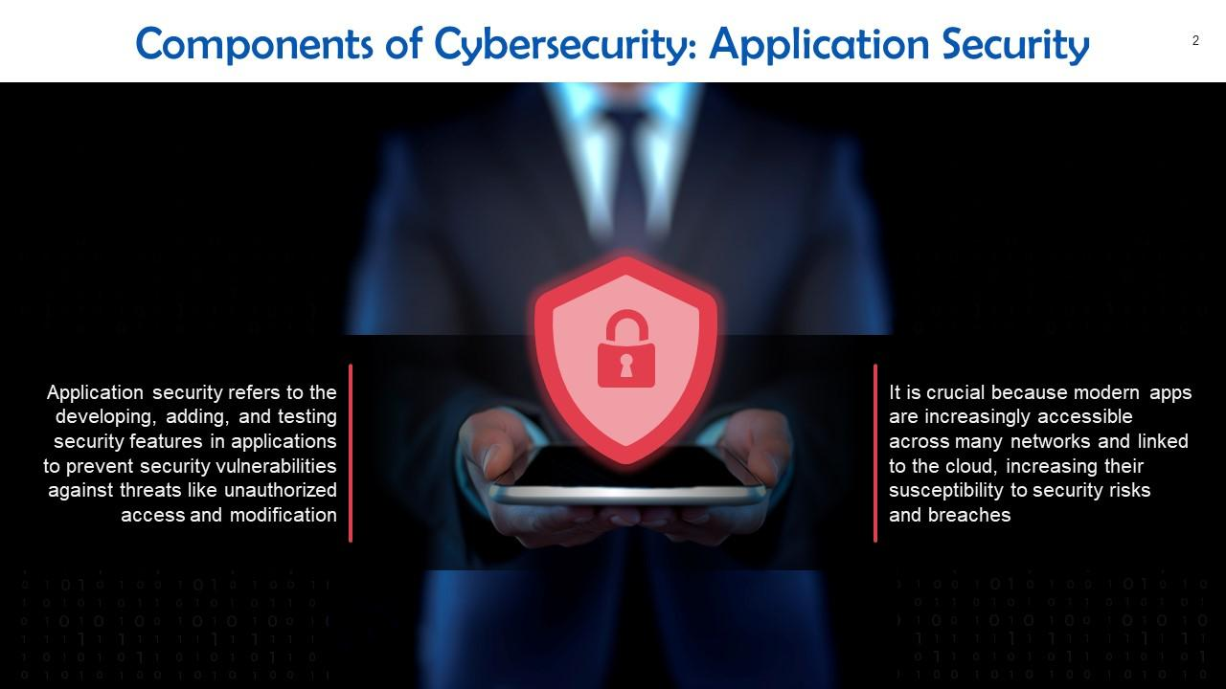

Slide 3
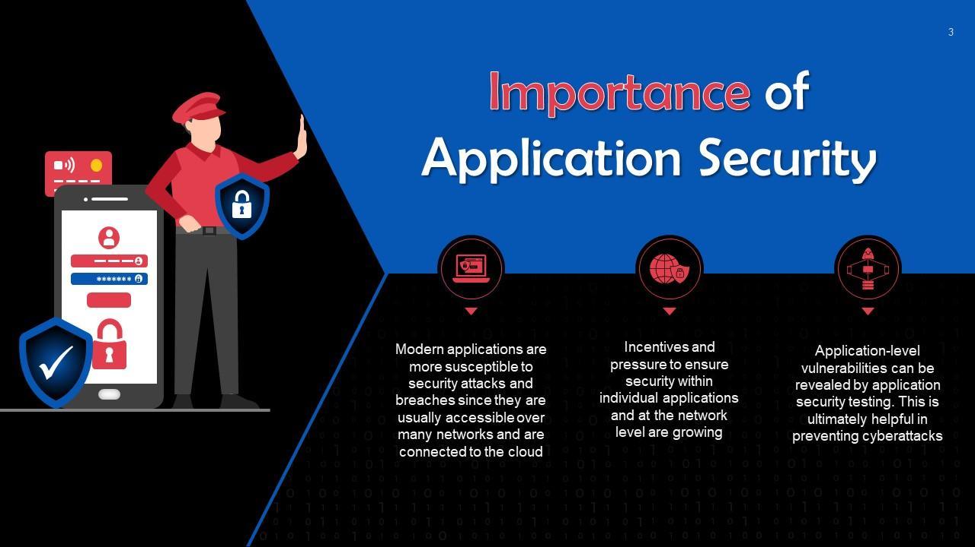

Slide 4
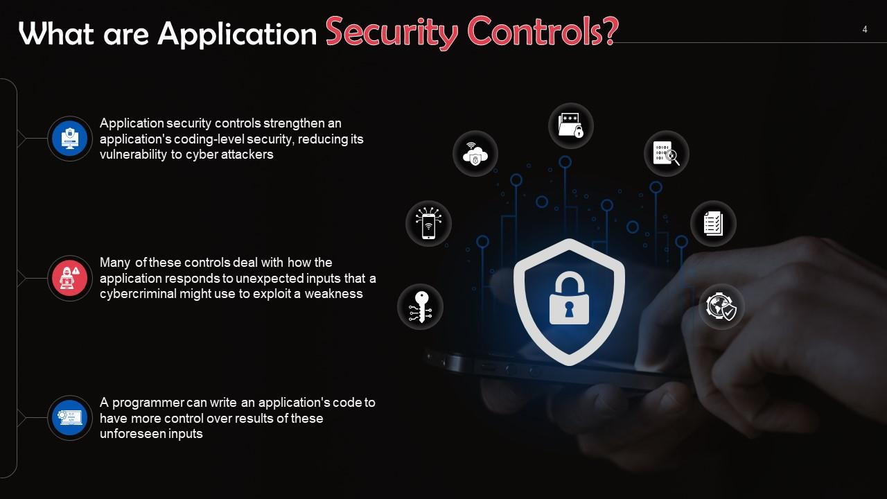

Slide 5
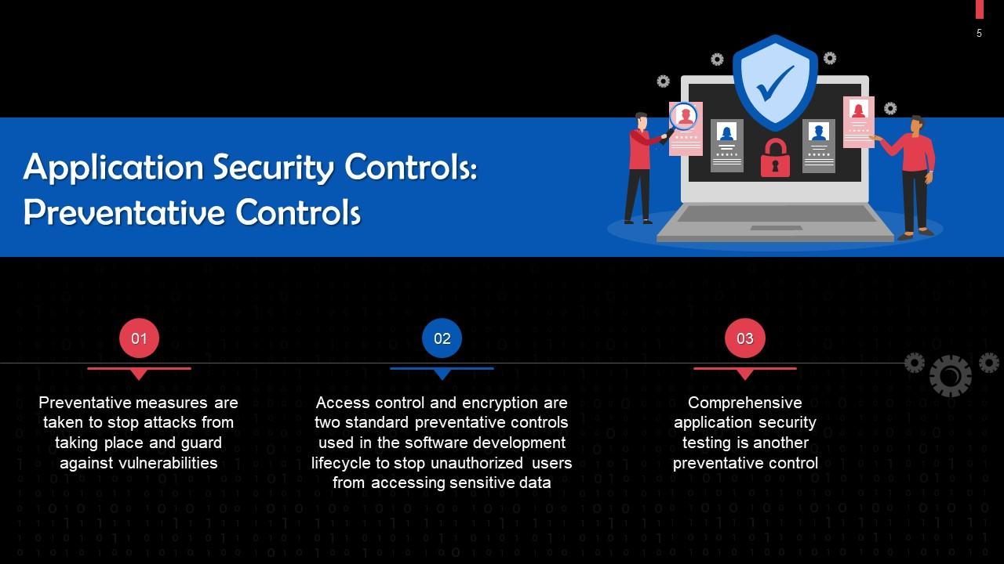

Slide 6
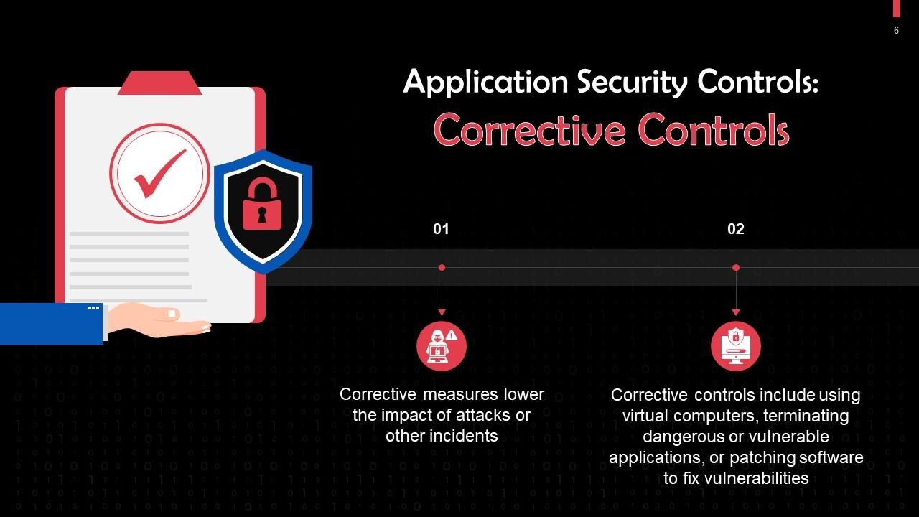

Slide 7
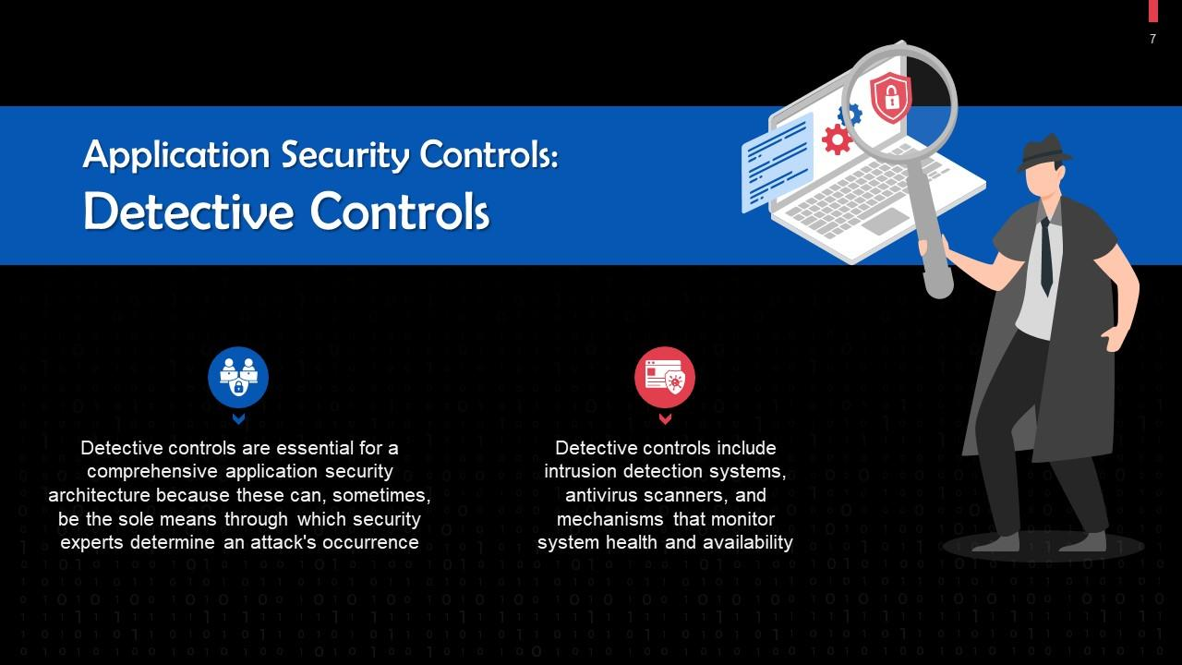

Slide 8
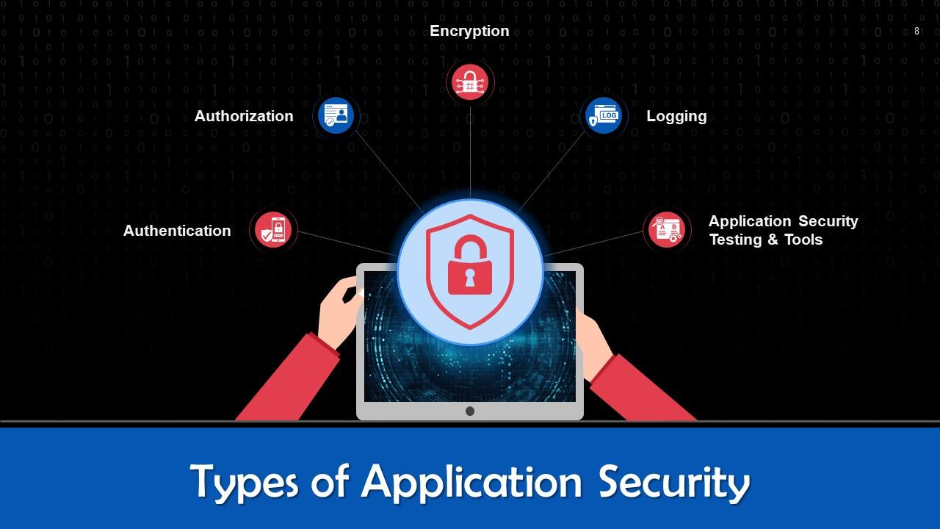

Slide 9
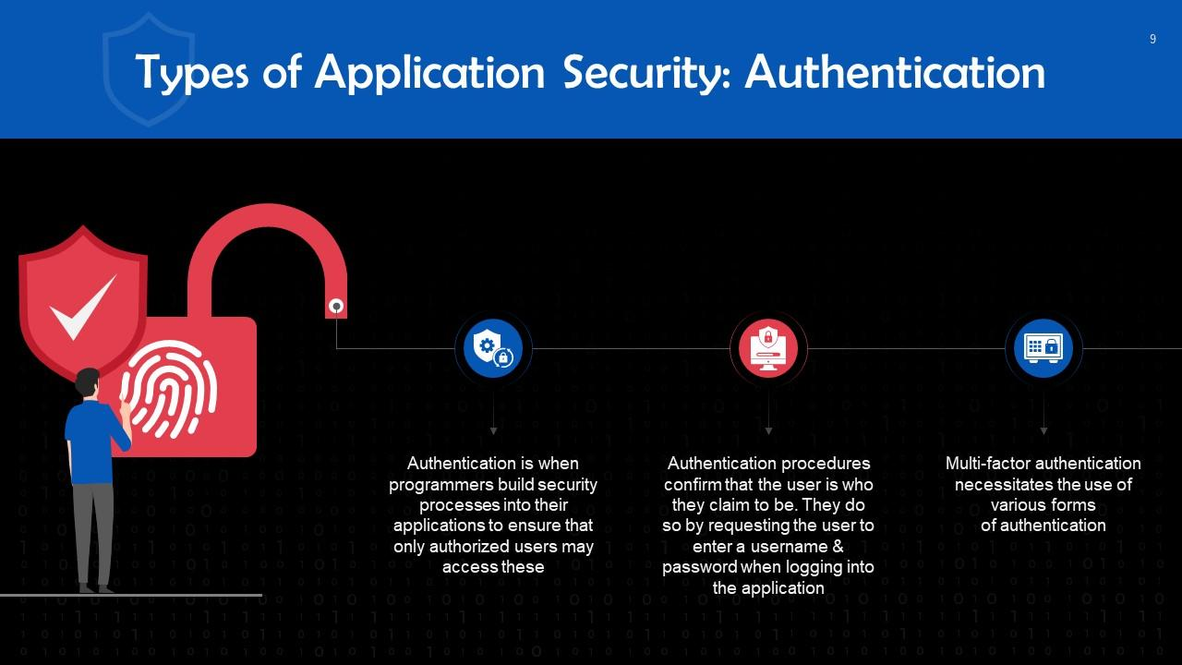

Slide 11
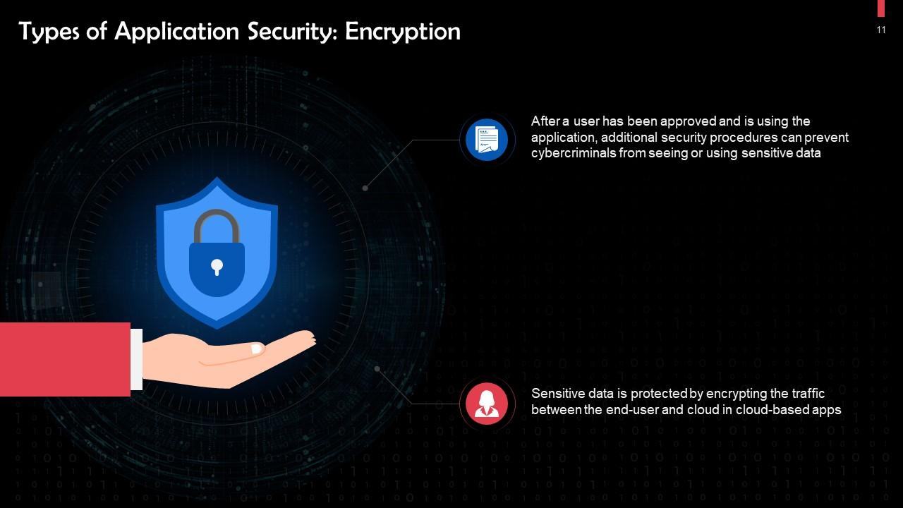

Slide 12
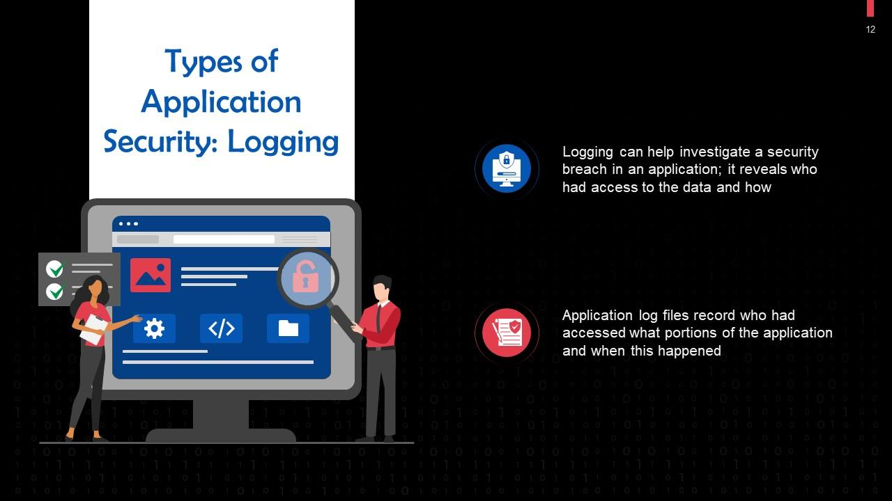

Slide 13
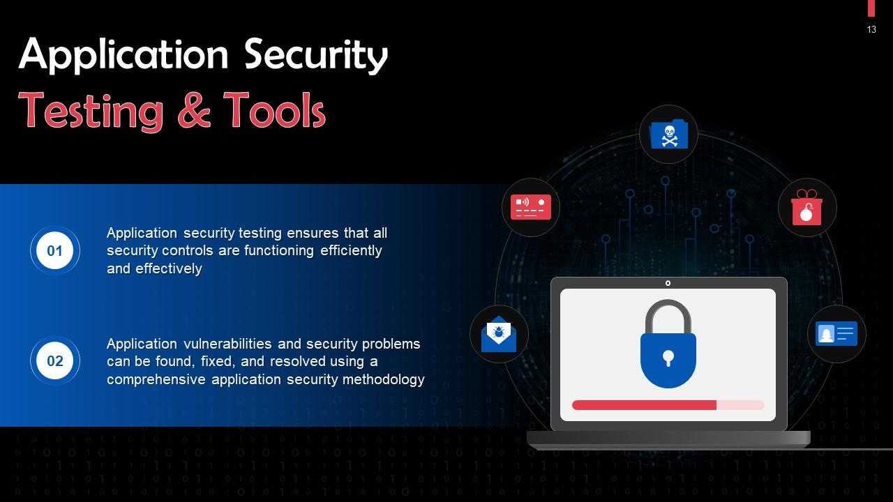

Slide 15
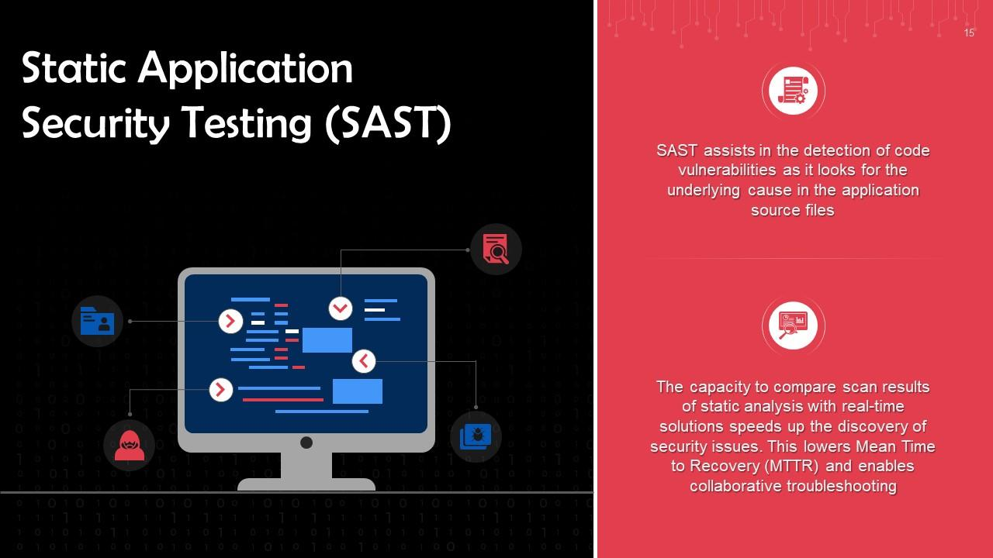

Slide 16
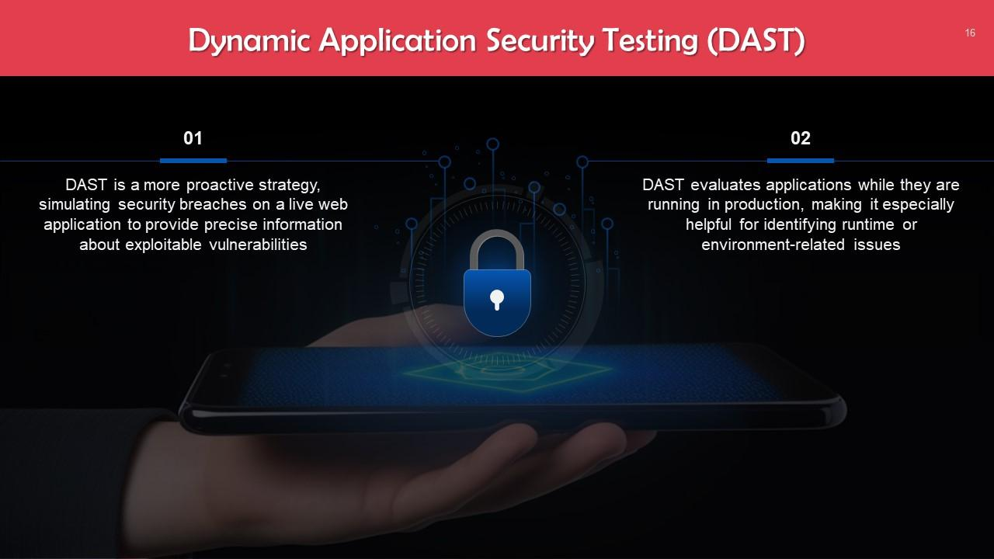

Slide 17
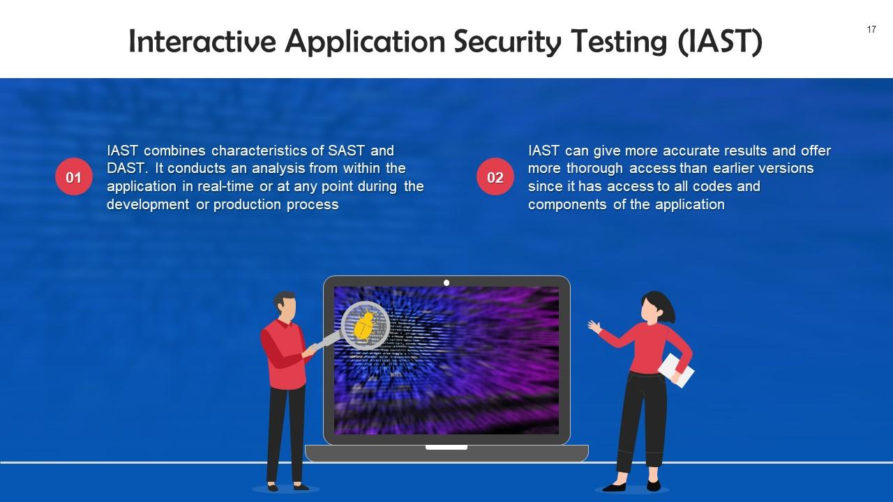

Slide 18
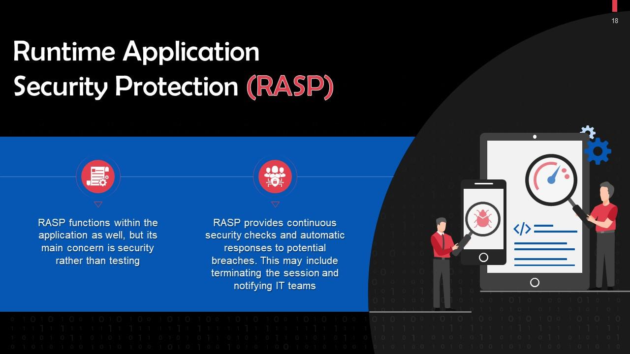

Slide 19
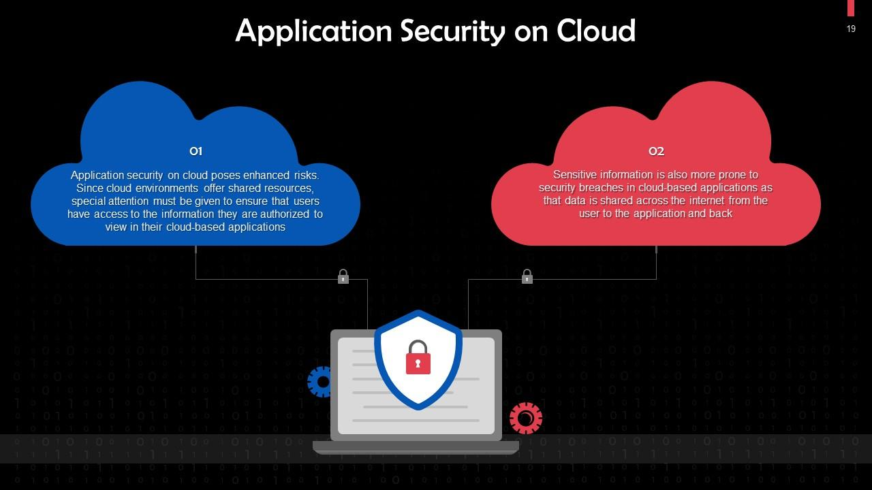

Slide 20
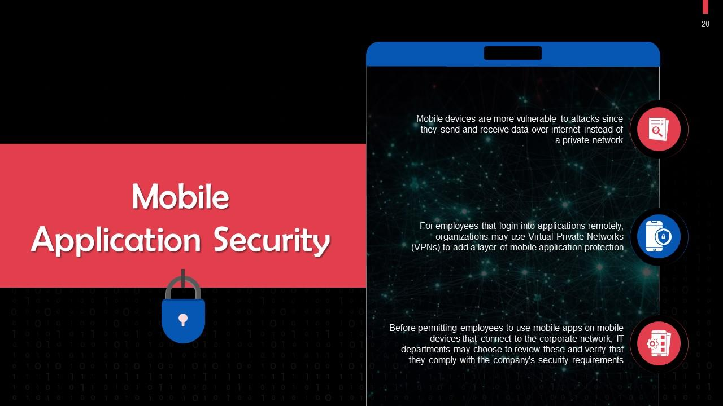

Slide 21
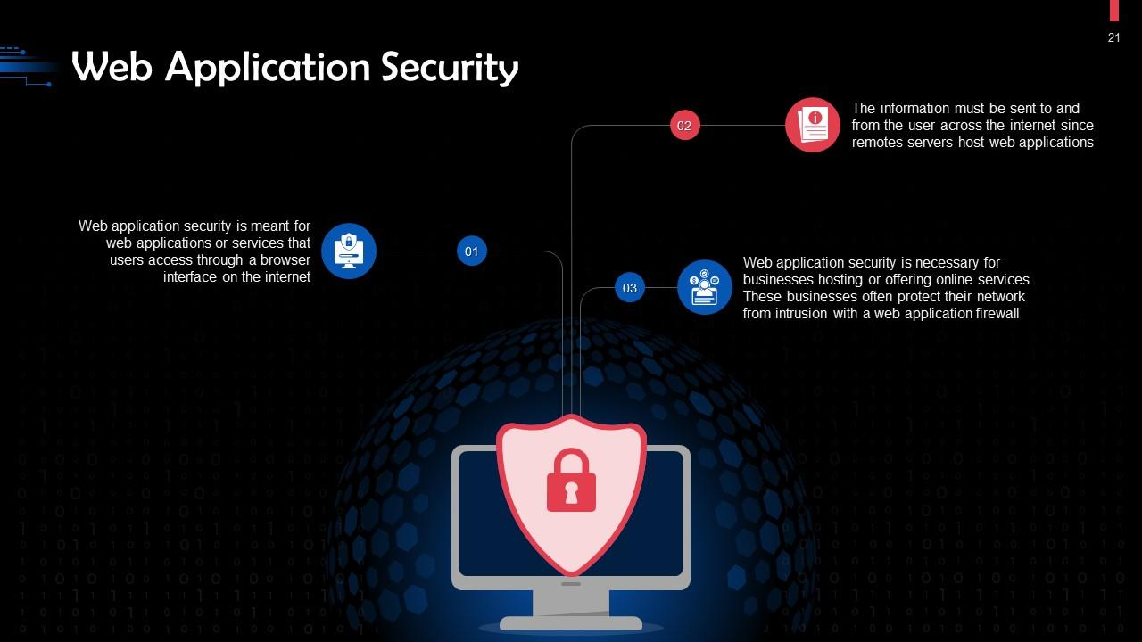

Slide 22

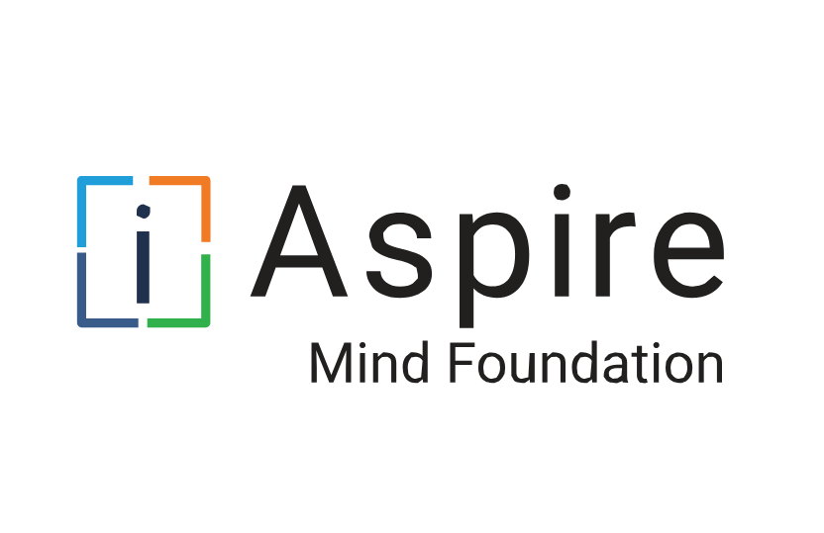
Risk Management

Slide 23

What is Risk Management?

Slide 24
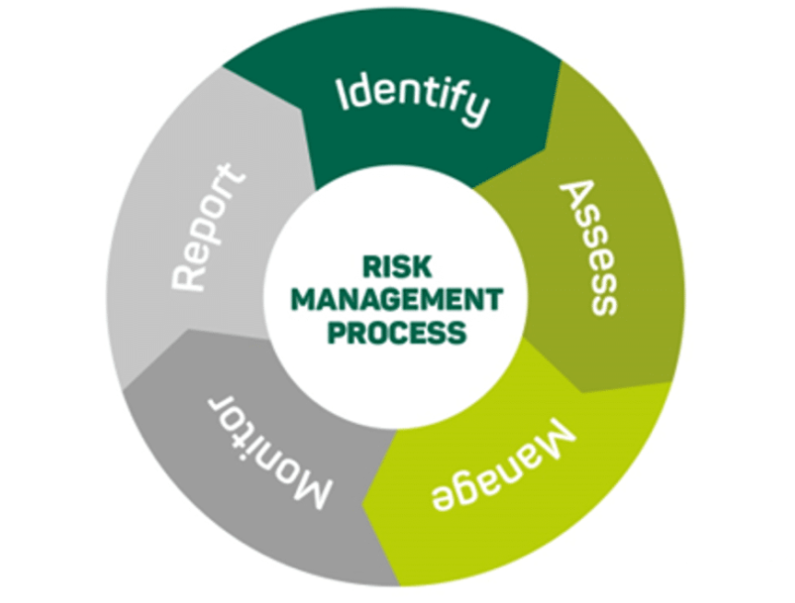
Risk Management Process
Risk management is a process for identifying, assessing, and mitigating vulnerabilities and threats to the essential functions that a business must perform to serve its customers.
Phases of Risk Management
Identify Mission Essential Functions
Identify Vulnerabilities
Identify Threats
Analyze Business Impacts
Identify Risk Response

Slide 25
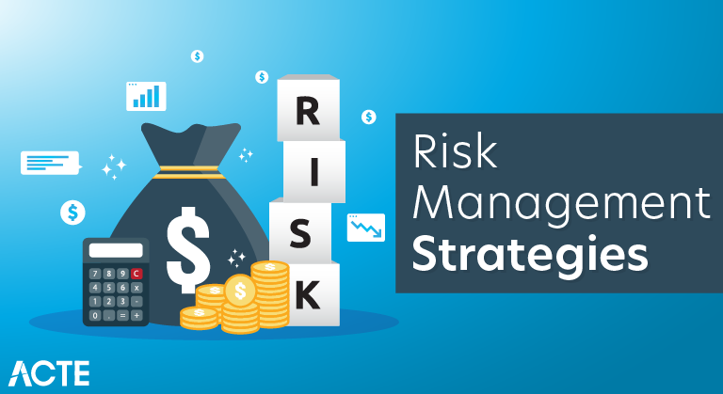
Risk Management Strategies
Risk Mitigation
Risk Deterrence
Risk Avoidance
Risk Transference
Risk Acceptance
Residual Risk
Risk Appetite

Slide 26
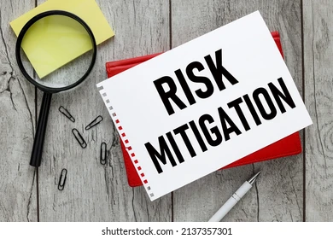
Risk Mitigation
This involves taking steps to reduce the severity or likelihood of a risk. It includes implementing controls or measures to minimize the impact of potential risks.

Slide 27

Risk Deterrence
This strategy focuses on discouraging actions that might lead to risk. It can involve measures that make risky actions less attractive or more difficult to undertake.

Slide 28

Risk Avoidance
This involves altering plans to eliminate a risk or choosing not to engage in activities that are considered too risky. Essentially, it's about not taking the risk at all.

Slide 29
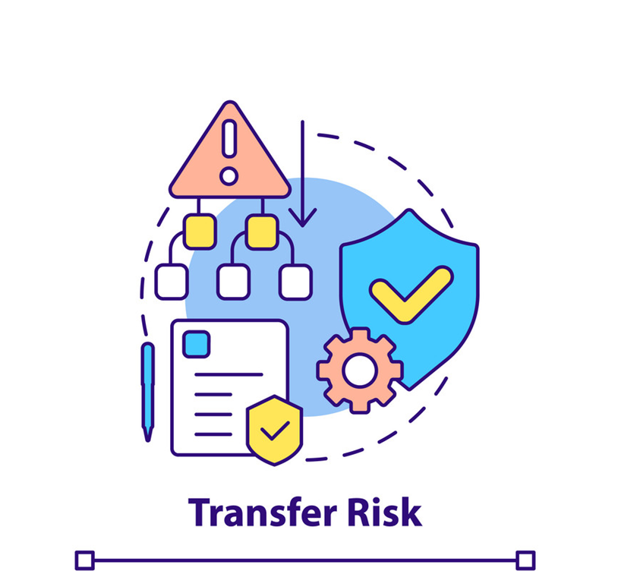
Risk Transference
This strategy involves shifting the risk to another party. Common methods include outsourcing, purchasing insurance, or entering into partnerships.

Slide 30

Risk Acceptance
Sometimes, the best strategy is to accept the risk when the cost of mitigating it is greater than the risk itself. This approach involves recognizing the risk and choosing to proceed with the understanding that the potential impact is manageable.

Slide 31
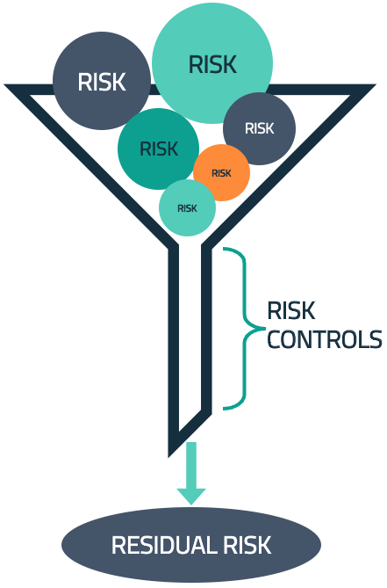
Residual Risk
This is the amount of risk that remains after all risk mitigation efforts have been implemented. It's the risk that is left over after controls have been applied.

Slide 32

Risk Appetite
This is the level of risk an organization is willing to accept in pursuit of its goals. It defines the amount and type of risk that is considered acceptable in order to achieve the organization’s objectives.

Slide 33
Data Classification and Compliance

Slide 34
Data Classifications
Data classification and typing schemas tag data assets so that they can be managed through the information lifecycle.
Data classification schema
Public
Confidential
Critical
Classification based on kind of information asset
Proprietary
Private/Personal Data
Sensitive
Restricted

Slide 35
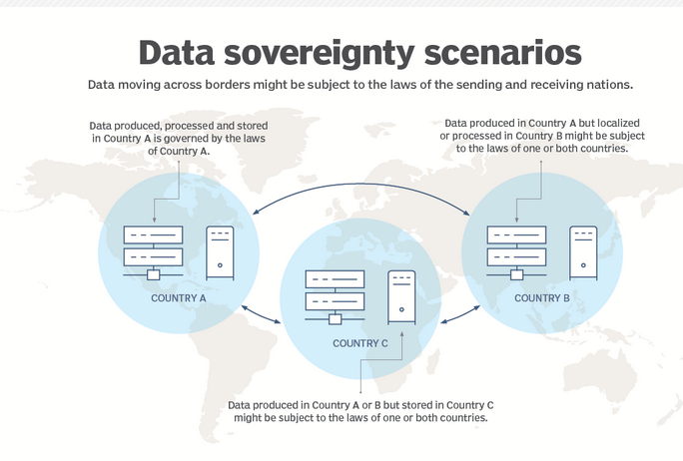
Data Sovereignty
Data sovereignty refers to a jurisdiction preventing or restricting processing and storage from taking place on systems that do not physically reside within that jurisdiction.

Slide 36
Geographical Considerations
Storage locations might have to be carefully selected to mitigate data sovereignty issues.
Employees needing access from multiple geographic locations.
Geographical Restrictions
Geolocation requirements impact data protection practices by requiring organizations to ensure data remains within a designated boundary, such as utilizing local datacenters or cloud providers.
Geolocation requirements impact incident investigation and forensics activities because they often include jurisdiction-specific data access and sharing restrictions, and other legal requirements.

Slide 37
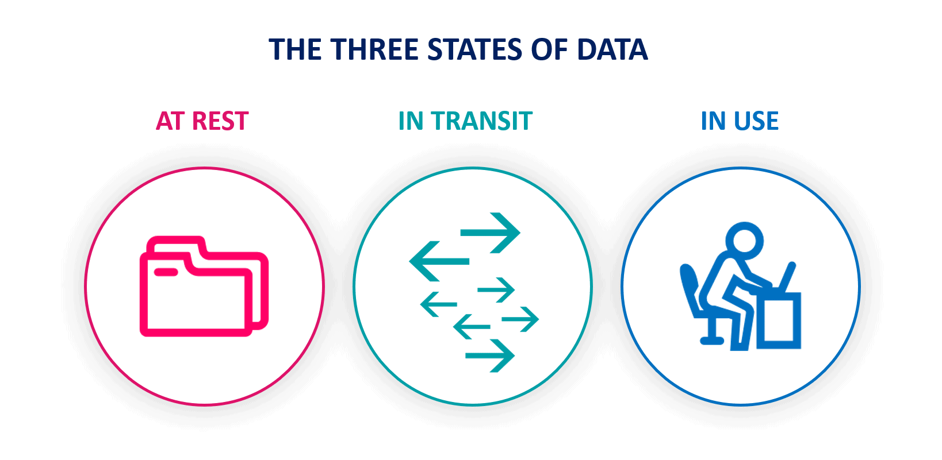
Data Protection

Slide 38
Data Protection
Data protection Methods
Geographic Restrictions
Encryption
Hashing
Masking
Tokenization
Obfuscation
Segmentation
Permission Restrictions

Slide 39
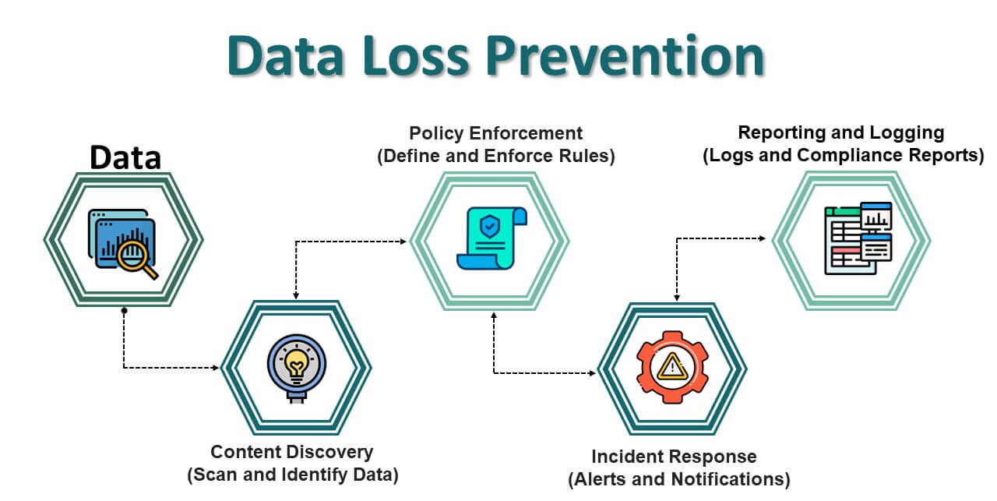
Data Loss Prevention

Slide 40
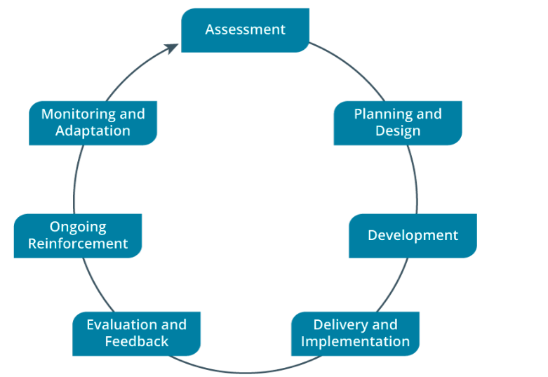
Security Awareness Training Lifecycle

Slide 41
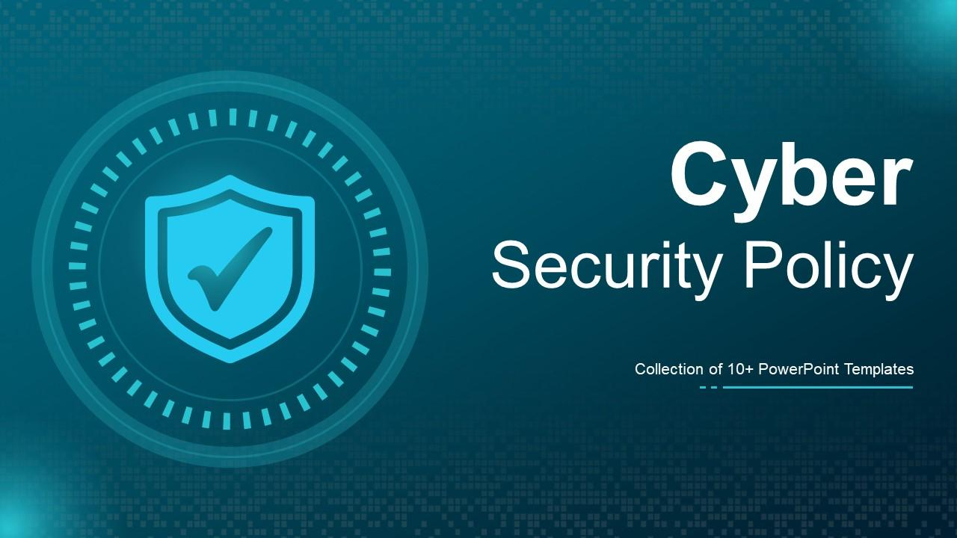

Slide 42
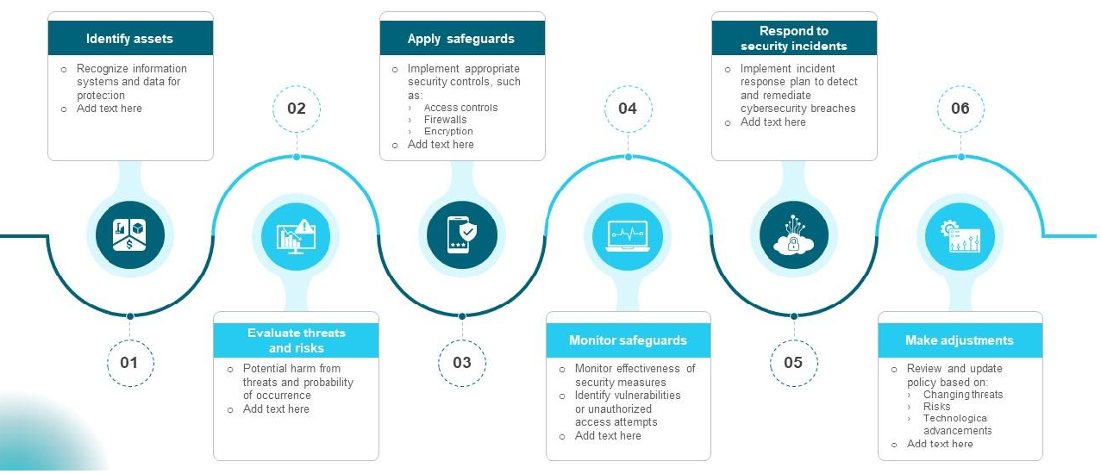
Steps in Cyber security Policy Cycle

Slide 43
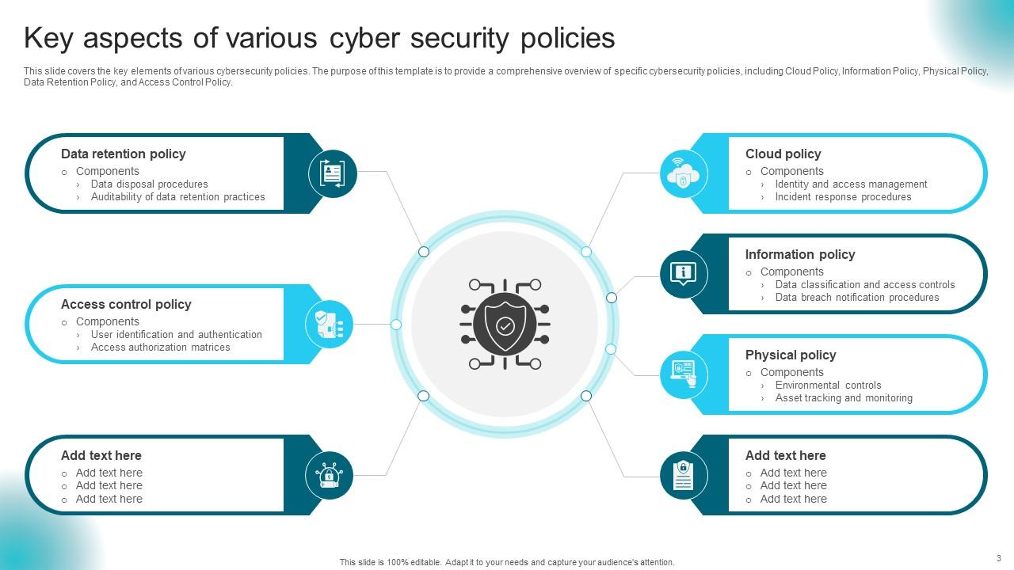

Slide 44
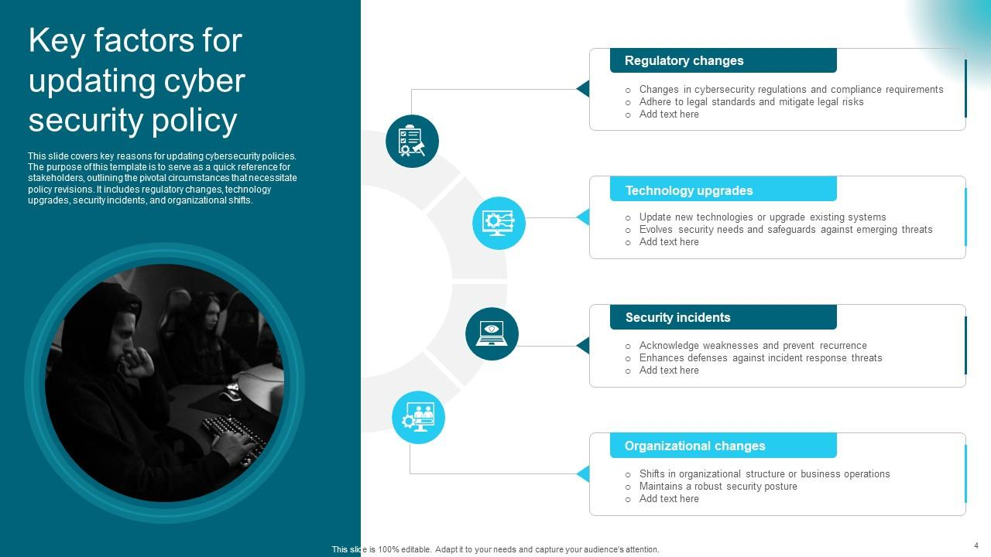

Slide 45
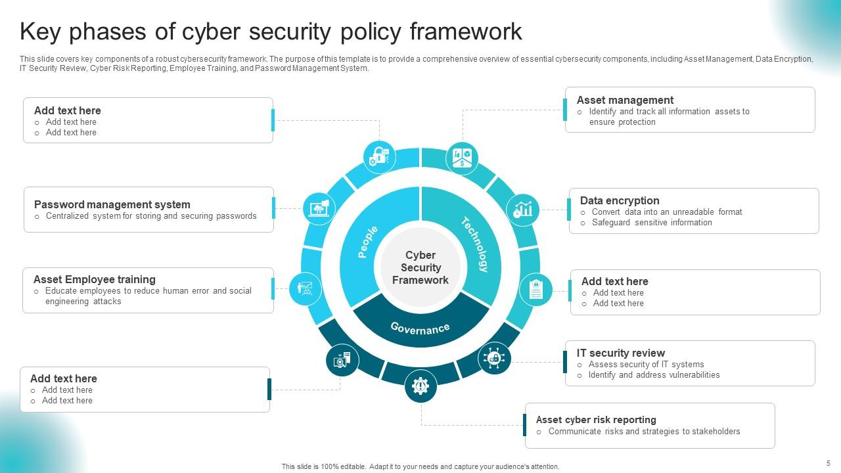

Slide 46
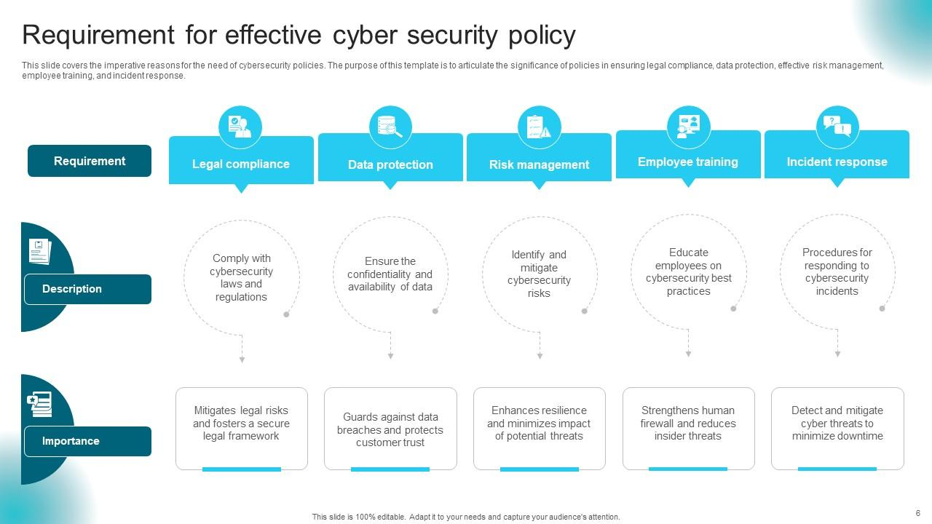

Slide 47
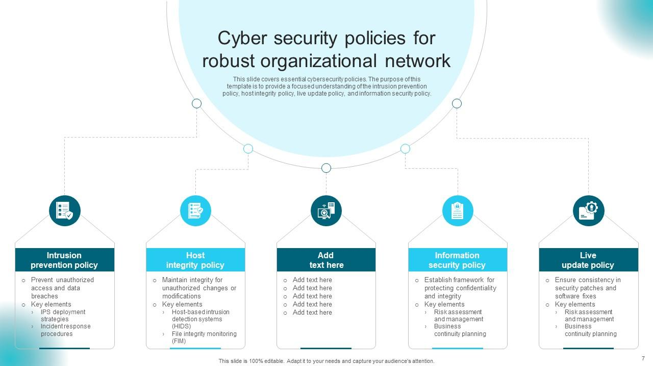

Slide 48
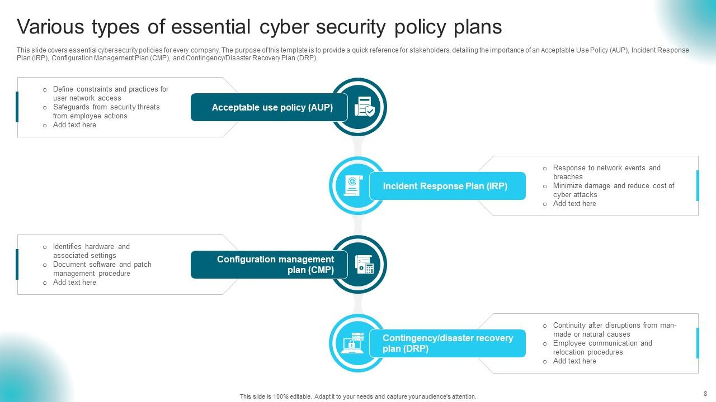

Slide 49
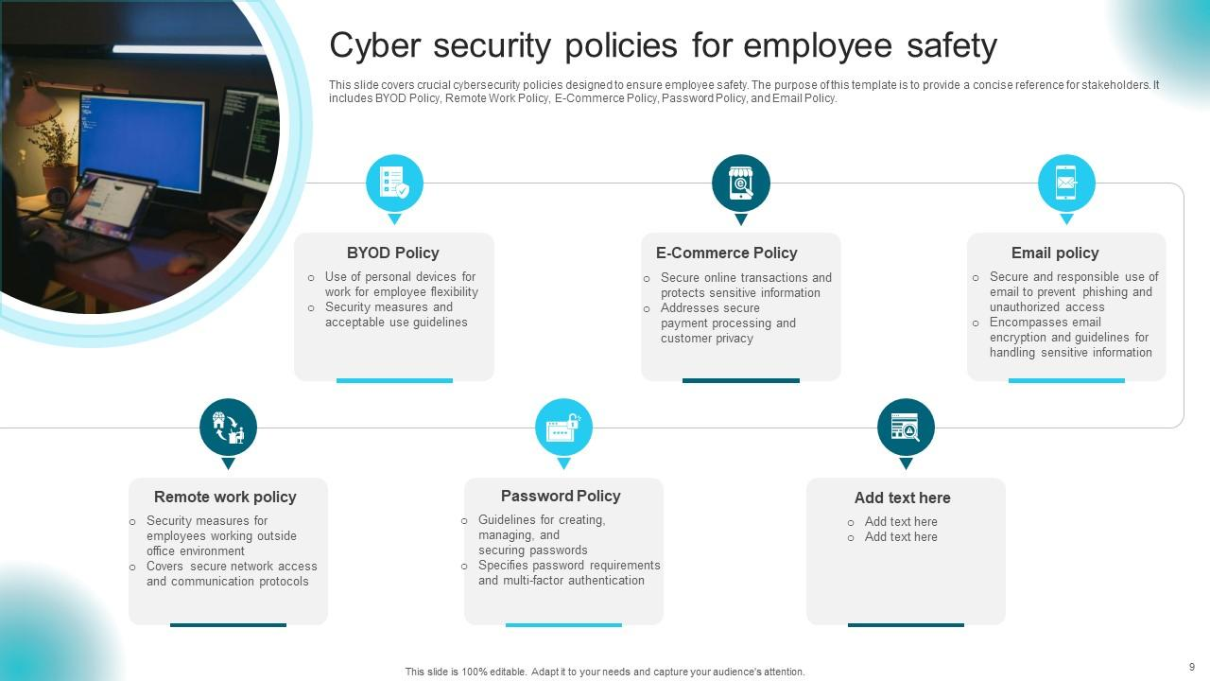

Slide 50
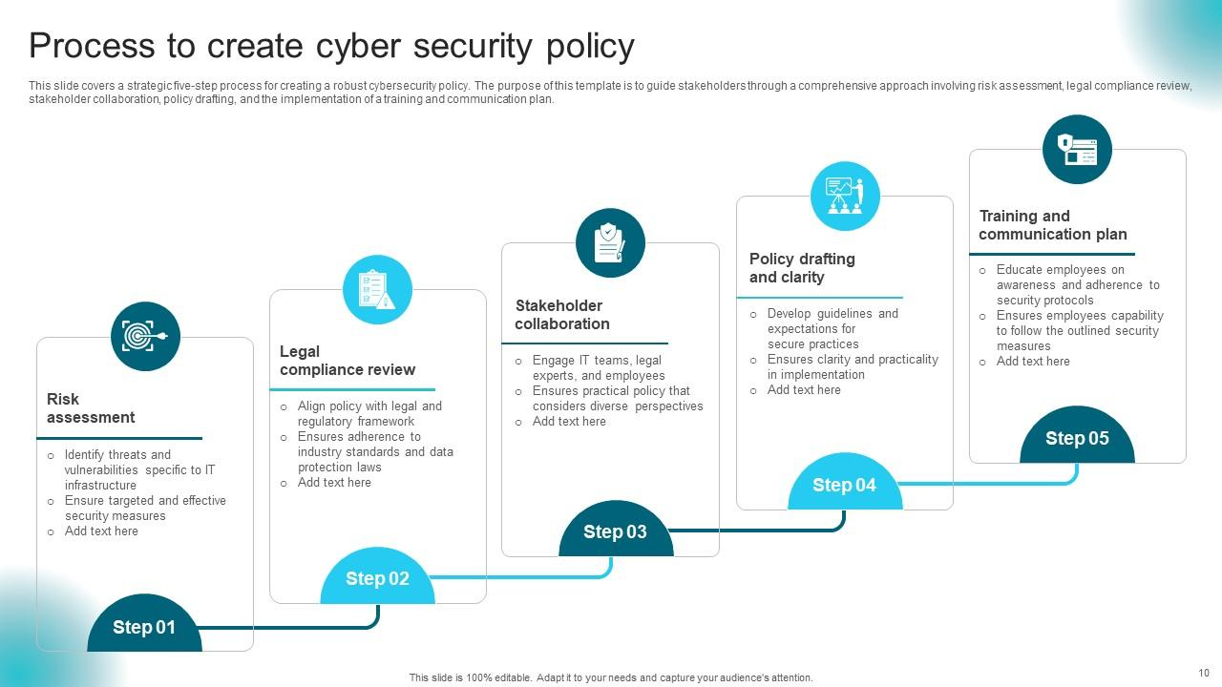

Slide 51
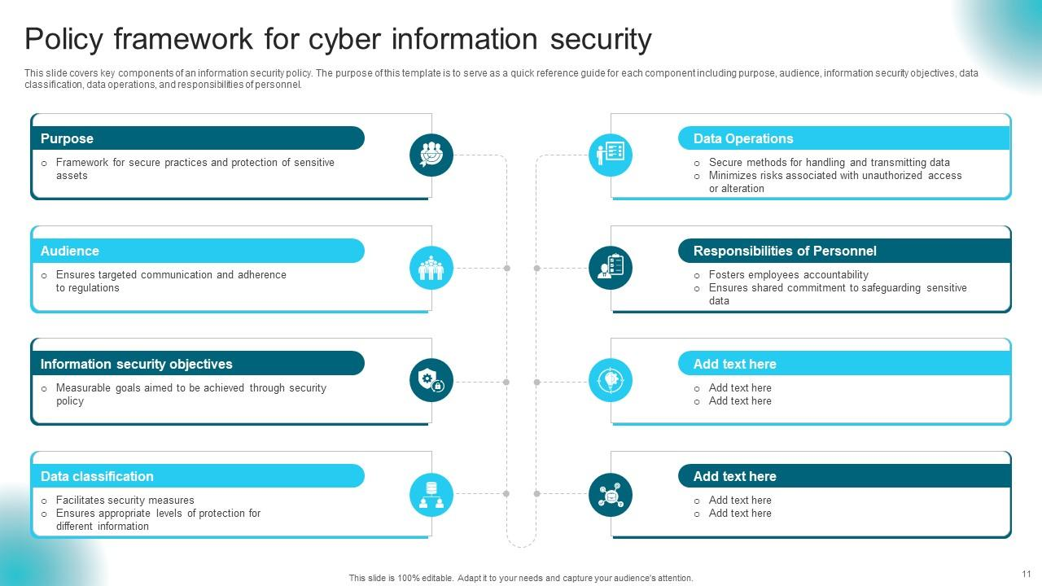

Slide 52
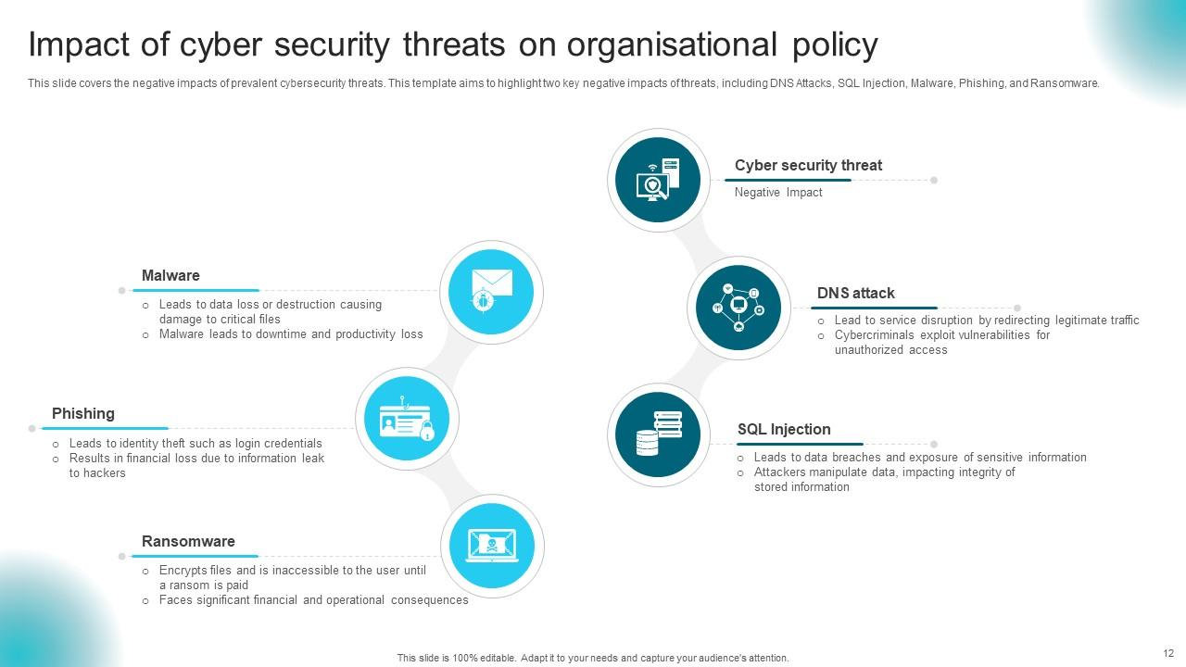

Slide 53
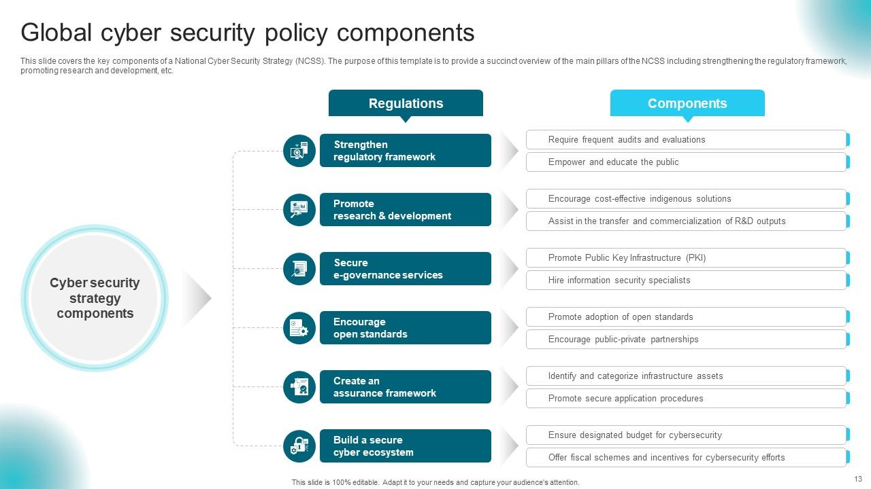

Slide 54
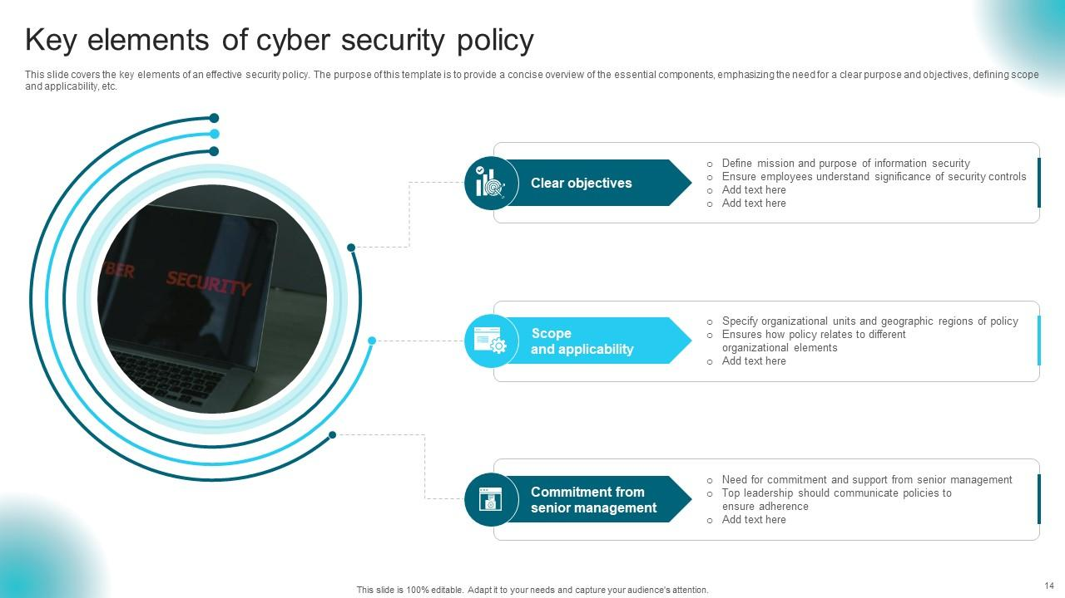

Slide 55
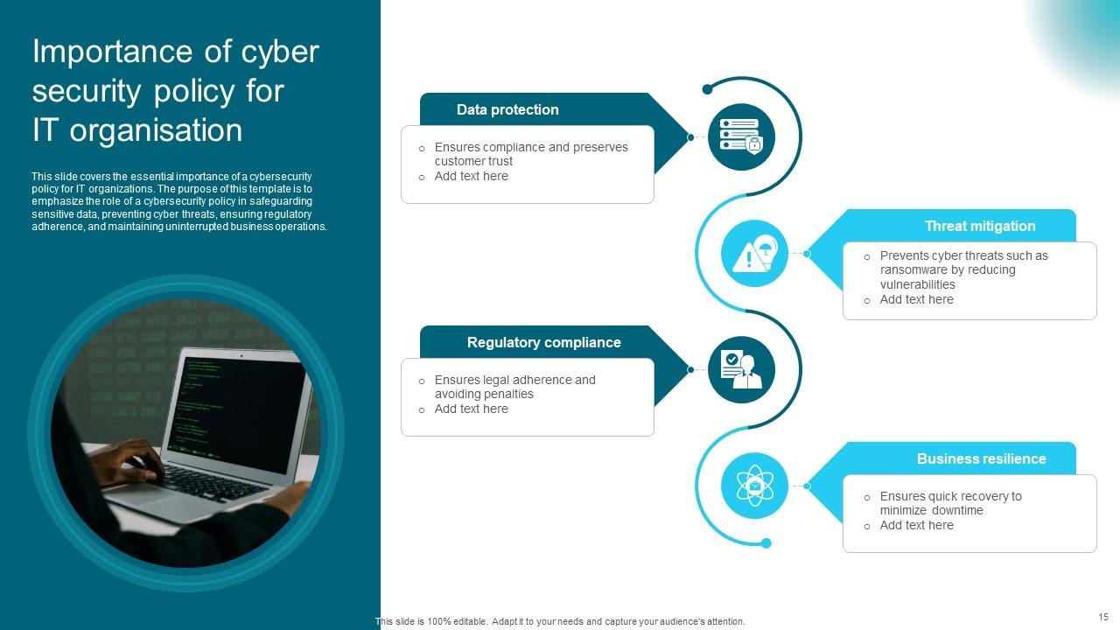

Slide 56
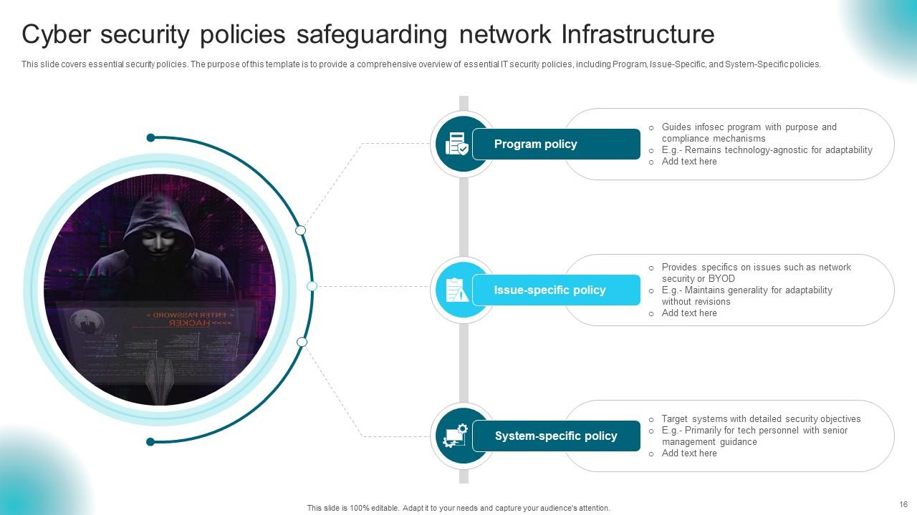

Slide 57
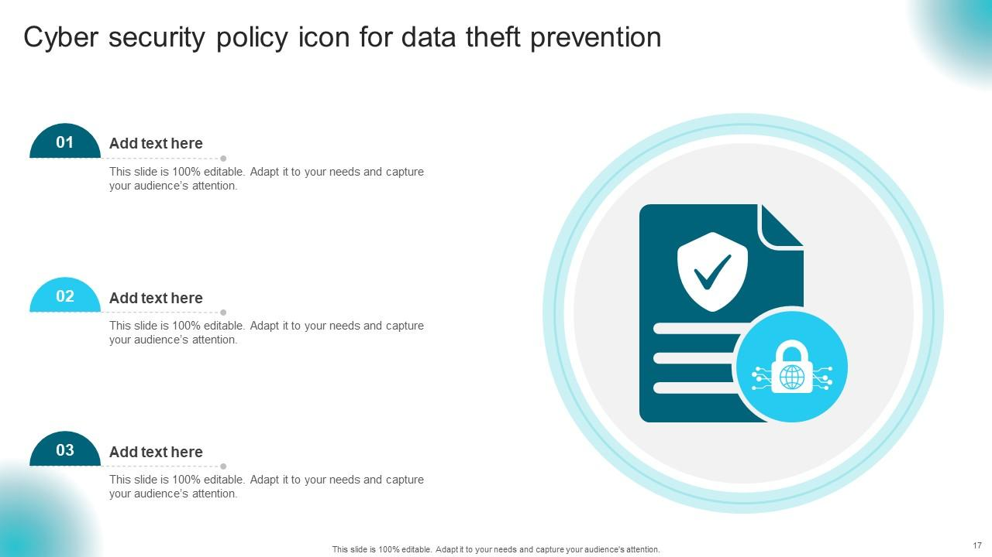

Slide 58
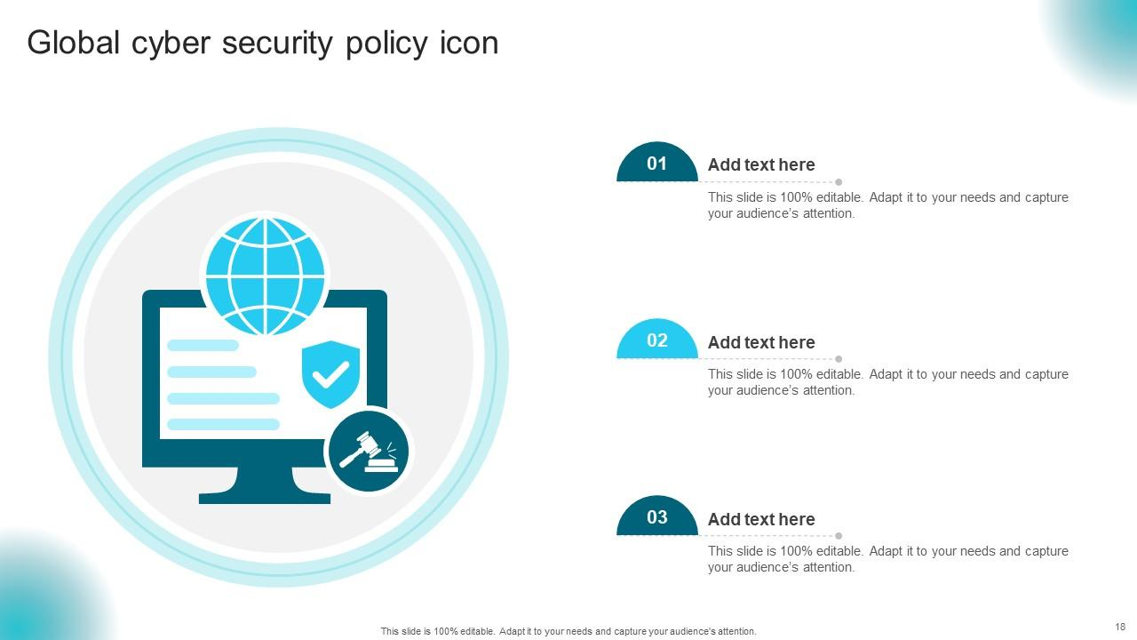

Slide 59
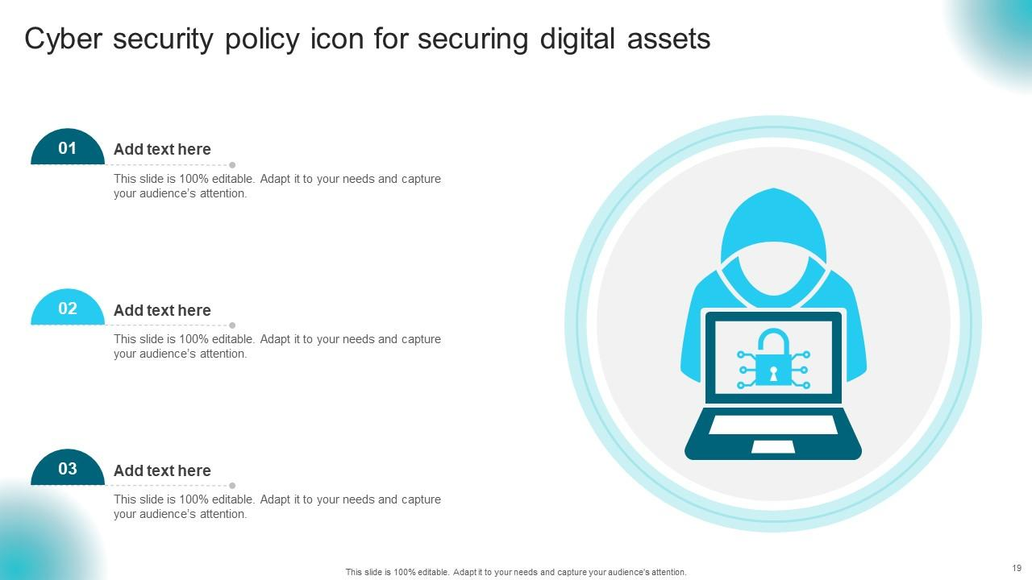

Slide 60


